Slide 1
Praktikum: Cloud Data Bases (IN0012, IN2106, IN4163)
Aly Kamel, Iremur Kidil, Ricardo Kraft
28.01.2020
Notes:
13s

Slide 2
Overview
Motivation
Use case scenario
Implementation
Perfomance Tests
Conclusion

Slide 3

I. Motivation
Redis – Pub/Sub
TOPIC
Publisher
(Sender)
Subscribe
Subscriber N
(Receiver)
Publish
Receive

Slide 4


II. Use Case Scenario
Cookie Factory

Slide 5
Cookie Factory
Global-Chat
NEW YORK
MUNICH
NYC MANAGER
MUC MANAGER
NYC-Chat
MUC-Chat
Brooklyn
Queens
Bronx
Garching
Pasing
Laim
Notes:
Kvs store to save orders
Exchange information regarding orders
Different communication channels for managers vs employees

Slide 6
I. Motivation
Group chat
CHAT ROOM
Client N
Sends
Sends
Client N
Receives
Receives
6

Slide 7
I. Motivation
1:N vs. N:N
1 : N
N : N

Slide 8




II. Use Case Scenario
Demands of the client
Unique usernames
Access database while chatting
Public chatrooms
Password protected private chatrooms
8

Slide 9

II. Use Case Scenario
Our solution

Slide 10
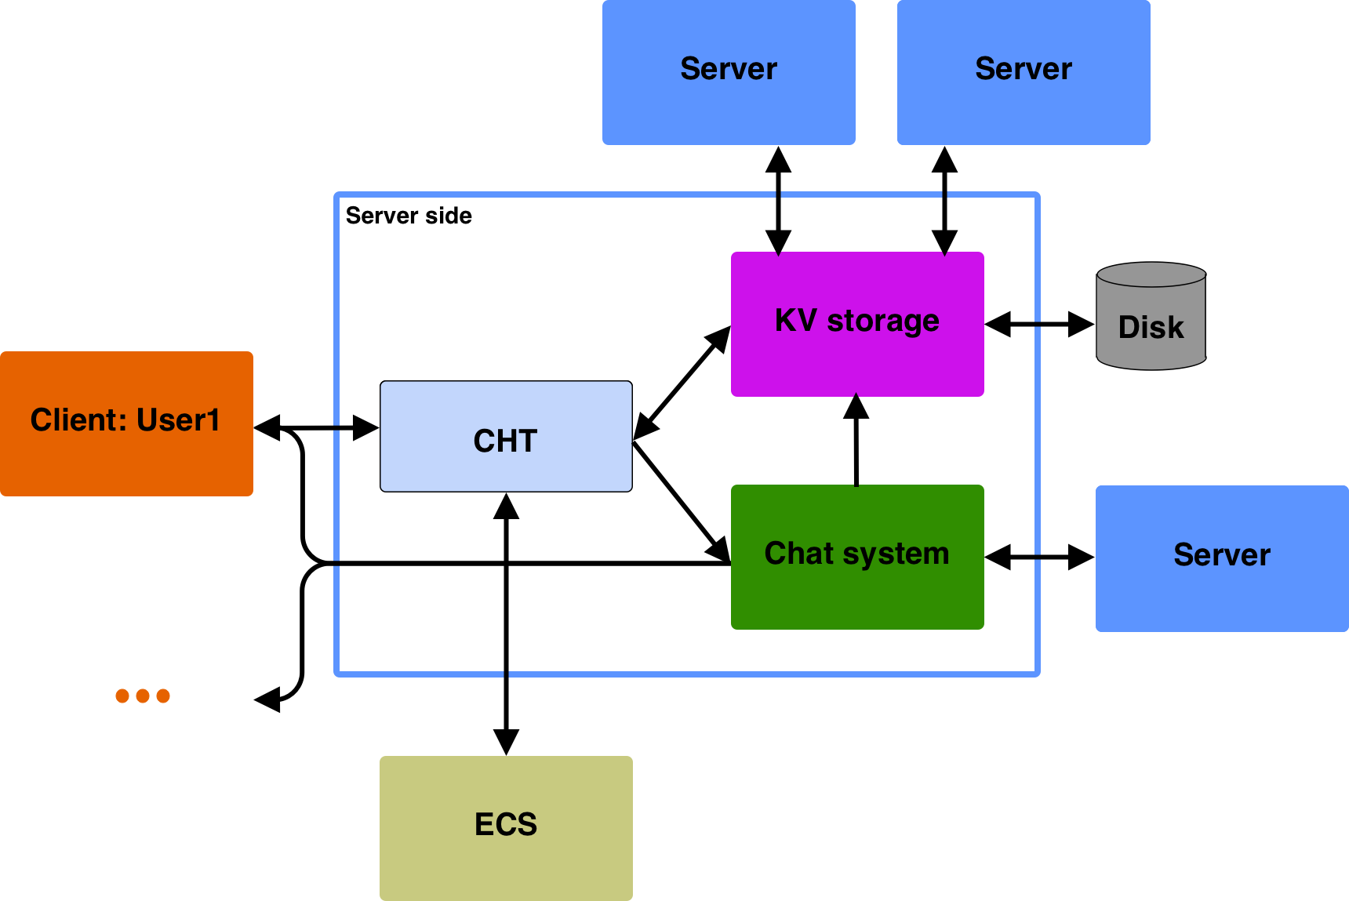

Slide 11
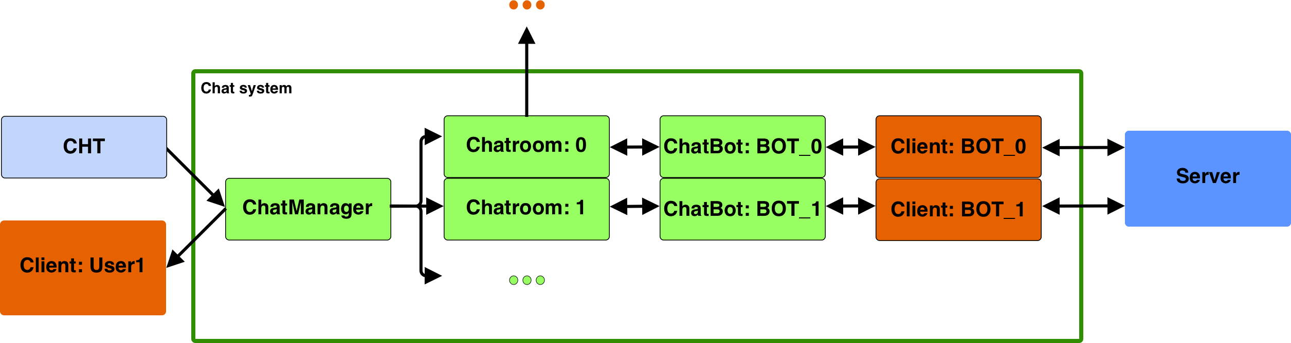

Slide 12






III. Implementation
Our steps
Create and join public chatrooms
Make them globally unique
Save the chat history
Write in the chat
Send notifications of joining and leaving users
Have a username

Slide 13

III. Implementation
Availability problem
Connecting to a chatroom uses the one and only socket of the client.
How do we access the database while being in the chatroom?
Increase the socket size? No, that would increase network traffic.
Exit the chatroom and rejoin quickly? No, we miss messages.
What do we do then?
The ChatBot.

Slide 14
III. Implementation
ChatBot
GarchBoss: Hey! I want to update my order, because I ran out of cookies.
GarchBoss: PUT garchingOrder “300 chocolate chip cookies, 200 apple cinnamon cookies, 500 white chocolate cookies“
MucManager: GET{garchingOrder}
MucManager: Only problem, I only have 400 of white chocolate cookies.

Slide 15
Key-value server
III. Implementation
Message handling
User1: I have GET{n} cookies
n
5
ChatManager
User1: I have GET{n} cookies
ChatRoom
ChatBot
I have GET{n} cookies
User1: I have 5 cookies
User1: I have 5 cookies
User1
Clients in the chatroom

Slide 16
III. Implementation
More Commands
ACTIVE
Returns a list of all users in the chatroom.
WSP <user1>,<user2>,…,<userN>
Sends a whisper to provided clients.

Slide 17
III. Implementation
Private chatrooms
Password protected chatrooms for e.g. filtering the regions
NEW YORK
NYC MANAGER
NYC-Chat
Brooklyn
Queens
Bronx

Slide 18
IV. Performance evaluaiton
Constants
320 keys from the EnronSet
Operation order: puts, gets, deletes on all keys
Key order randomized
Cache replacement strategy: LRU
Cache size: 16 (5% of 320)
Tests run 5 times, average taken

Slide 19
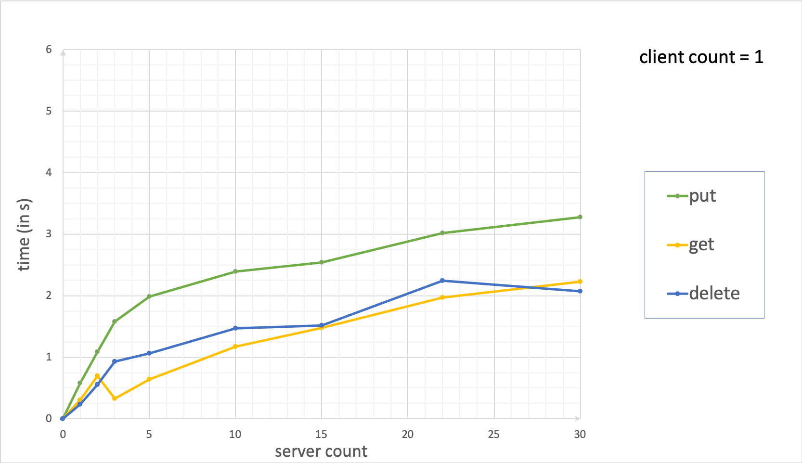

Slide 20
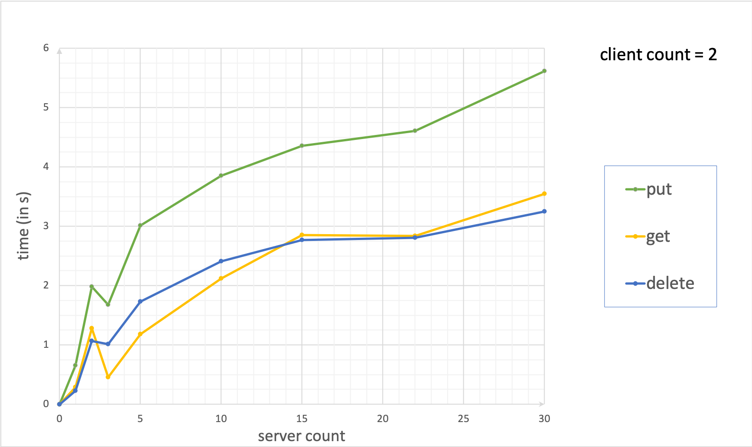

Slide 21
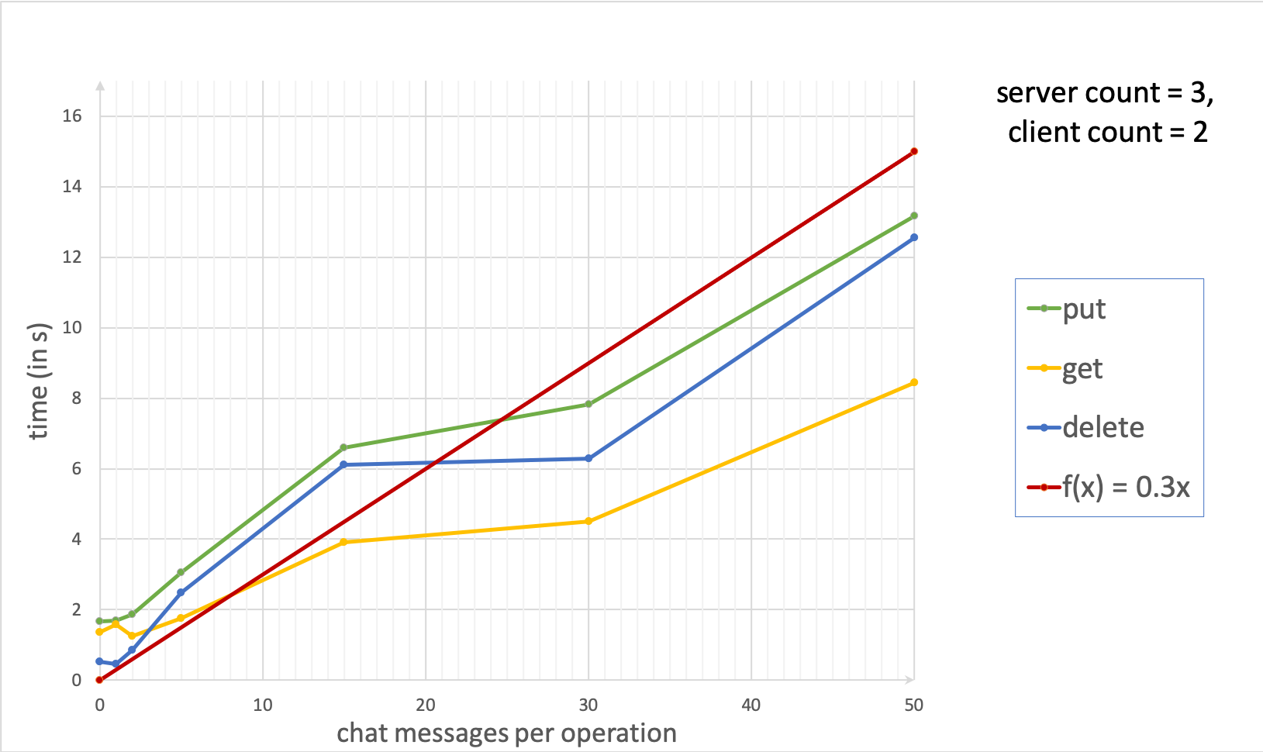

Slide 22
V. Conclusion
Pros
Light-weighted communication
Acces to database while chatting
Reduced network traffic
Cons
Limited number of chatrooms
Limited number of clients
ChatBot is bottleneck
Notes:
recommendation

Slide 23
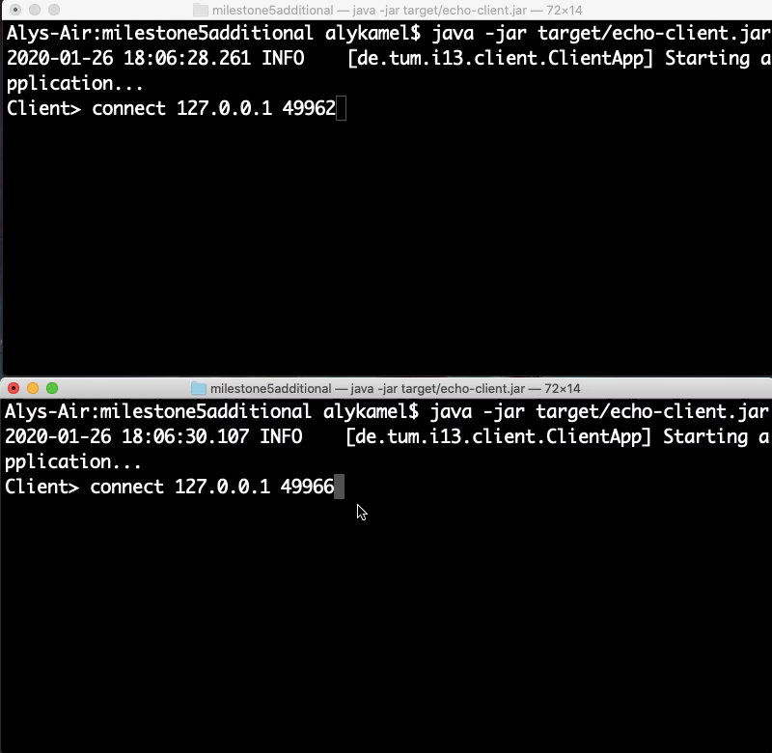
VI. Demonstration

Slide 24
THANK YOU FOR YOUR ATTENTION!

